Slide 1
Capital Bikeshare project
tom dirienzo, Chidi Ogbejesi,
Alpesh patel, Pat wolfe,

Slide 2
outline
Objectives
Tools
Data Sources
Methodologies
Analysis
Tableau
Statistical Analysis
Machine Learning
Conclusions

Slide 3
Objectives
Identify bike share demographic trends, predict usage rates
What type of riders use and do not use bike share?
When do bikeshare stations empty?
Notes:
* [ ] Summarize where and how you found the data you used to answer these questions
* [ ] Describe the data exploration and cleanup process (accompanied by your Jupyter Notebook)
* [ ] Describe the analysis process (accompanied by your Jupyter Notebook)
* [ ] Summarize your conclusions. This should include a numerical summary (i.e., what data did your analysis yield), as well as visualizations of that summary (plots of the final analysis data)

Slide 4
Tools & Data Sources
Sci-Kit Learn
LinearRegression
RandomForest
AWS/Flask/Heroku
Template Inheritance
Python
Pandas
Numpy
Matplotlib
GeoJSON
Leaflet
Shapely
HTML/CSS/Bootstrap
Tableau
Capital Bike Share Locations
Station
Lat / Long
Capital Bike Share Trip History Data
Station start / end
Datetime start / end
Capital Bike Share Real Time Data
Station
Docks number full / number empty
US Census Bureau [American Community Survey 5-Year Data (2009-2017)]
DC Ward Housing, Social, Economic, Demographic data
DC Data
DC Ward GeoJSON Boundaries
Historical Weather Metrics
Temperature
Precipitation

Slide 5





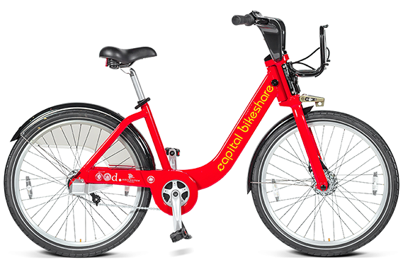

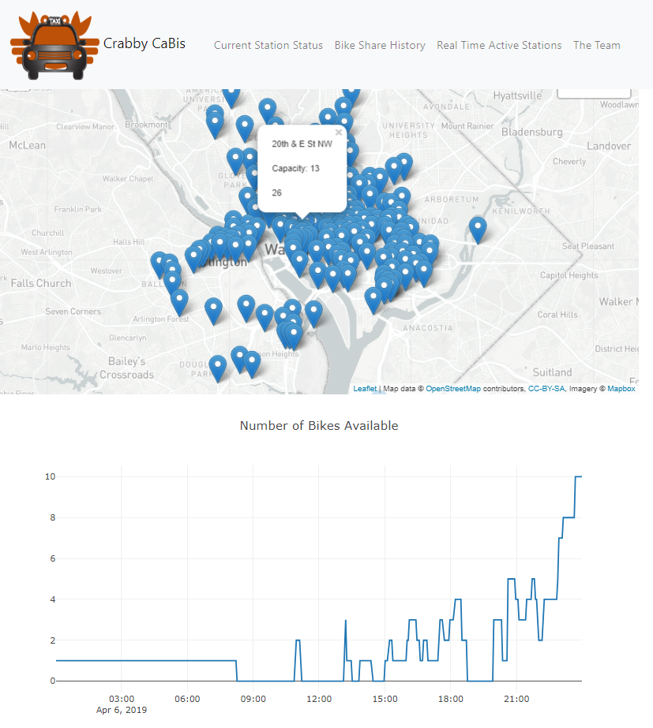


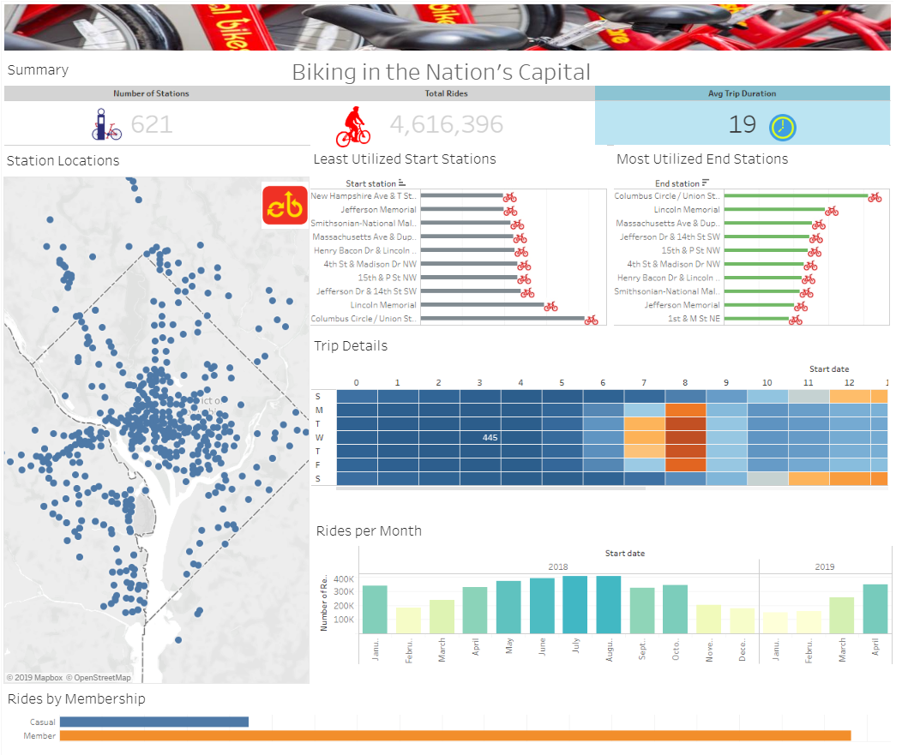
Hourly Weather Data
Team’s own API Connection
Teams SQL DB on AWS
24/7 Data
LIVE API Interface to Capital Bikeshare System Data

Slide 6
Tableau

Slide 7
Statistical Analysis
Model - Estimated | Score
Commuting To Work - Mean travel time to work (minutes) | 0.77
Gross Rent - $3,000 or more | 0.76
School Enrollment - College or graduate school | 0.66
Employment Status - All parents in family in labor force | 0.73
School Enrollment - Nursery school, preschool | 0.67
Rooms - 2 rooms | 0.84
Rooms - 3 rooms | 0.70
Rooms - 4 rooms | -
Marital Status - Now married, except separated | 0.01
Sex And Age - 35 to 44 years | -
World Region Of Birth Of Foreign Born - Latin America | -
Hispanic Or Latino And Race - Hispanic or Latino (of any race) | 0.01
Language Spoken At Home - Spanish | -
Industry - Agriculture, forestry, fishing and hunting, and mining | -
Bike share usage correlations
Strong between mid to higher income proxies, young people and families, distance from home to work
Weak / none between lowest and highest incomes proxy measures, Spanish speaking households, and married couples

Slide 8
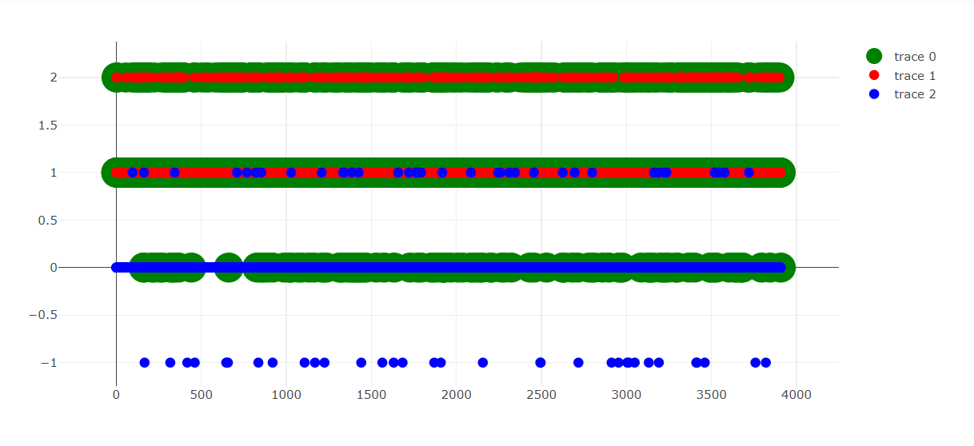
We took a walk down a random forest
It was lovely, dark, and deep
But we had predictions to keep! and miles to go before we sleep
Start with your Lit Review
Kudos to Joe Paolicelli and the Mission Data team
They answered the same question…And their means of categorizing the weather help tremendously
We used our historic bikeshare set on AWS (I’m still paying), some FREE weather data, and a lot of brain power under the hood that I still don’t understand
We ran our RF loop through all of our stations… and finished all 533
The models were saved for later use… our next GW boot camp
Don’t be an amateur Data Scientist – keep in mind cyclical data!

Slide 9
Conclusions
Bike share should extend outreach to lower income and Latin American communities (and fishermen)
Add more docking stations and educate potential new users
Spanish language terminals and website
Machine Learning works?

Slide 10

Q & A

